Slide 1
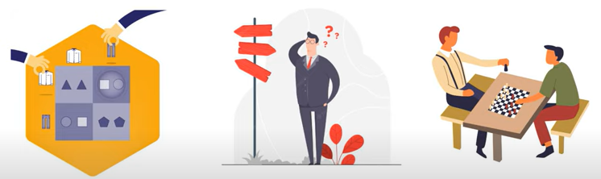
Game Theory
Basic Concepts and Terminology

Slide 2
Introduction
The study of mathematical models and their interaction with the decision-makers
The game theory includes strategic thinking in which players make decisions
viewing various perspectives
looking at the viewpoint of other participant players
Analyze the actions and reactions in particular situations

Slide 3
Significance
The best use of game theory is to figure out the optimal solution from the best possible choices
through the analysis of costs and benefits to each participant who competes with each other
The theory is applicable in different fields, like business, psychology, biology, economics, political science, computers, etc.
Business managers can use game theory to predict competitors' and collaborators' strategic planning
Game theory forecasts outcomes of interactions where one's reaction depends on others' actions.

Slide 4
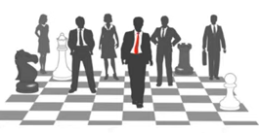
Understanding the Game Theory (elements)
Game
It refers to certain events or circumstances, wherein the outcome is dependent upon the actions or the decisions of the players involved
Players
It refers to the people that make the strategic decisions in the game

Slide 5
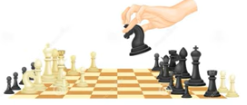
Strategy
It refers to the set of actions taken by the player to deal with the various circumstances that may arise in the game
Payoff
It refers to the payout that the player gets if he/she arrives at any specific outcome.
The payout could be money or other profitable or beneficial items
The information set
It is the pieces of information that are given at any specific time during the game

Slide 6
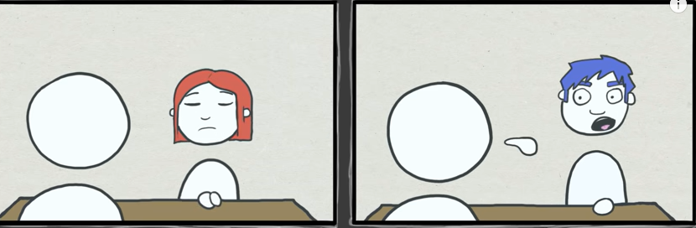
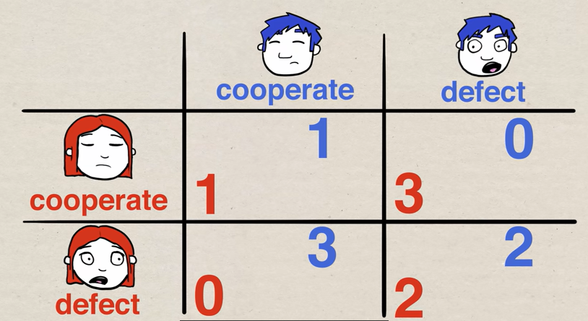
Prisoner’s
Dilemma

Slide 7
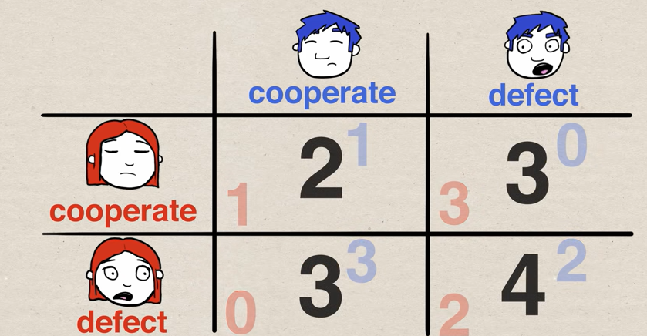

Slide 8
https://www.britannica.com/science/Nash-equilibrium

